Slide 1


7143CEM Mini-lecture 3-1b: Data Science Lifecycle
School of Computing, Electronics and Mathematics Coventry University
7143CEM Programming for Data Science 2021/22 Semester 1

Slide 2
Recap
What is Data Science?
A process of using data to understand things – tell a story
Science (apply the scientific method) – observe, explore, build models, make predictions
Collection of topics/tools (Data Scientist’s superpowers)
Analytics is “the scientific process of transforming data into insights for the purpose of making better decisions”
Descriptive/diagnostic/predictive/prescriptive analytics
“Data never sleeps” – data always being generated

Slide 3
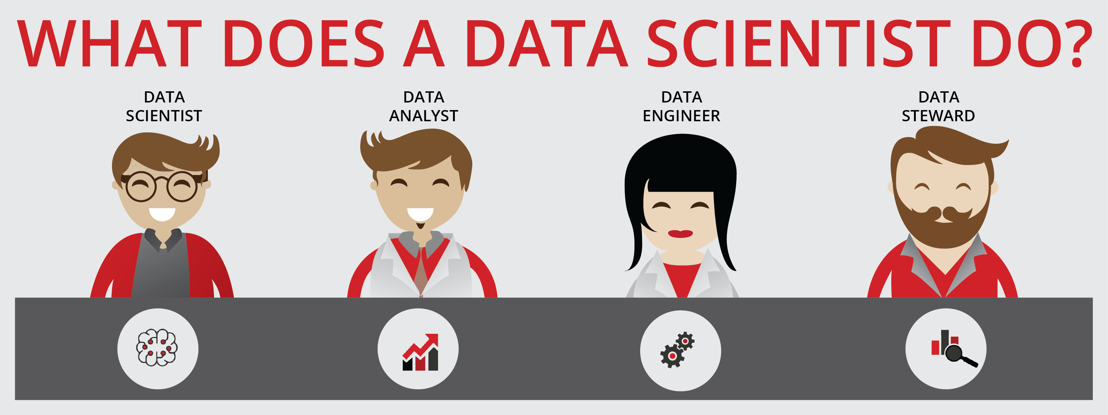
What does a Data Scientist do?
Ask questions (like a business analyst)
Get and store the data (like a data engineer)
Explore the data (like a data analyst)
Model the data (like a machine learning engineer)
Communicate results (like a data visualisation engineer)
Notes:
Article: https://medium.com/dataseries/what-does-a-data-scientist-do-a6553dc720f

Slide 4
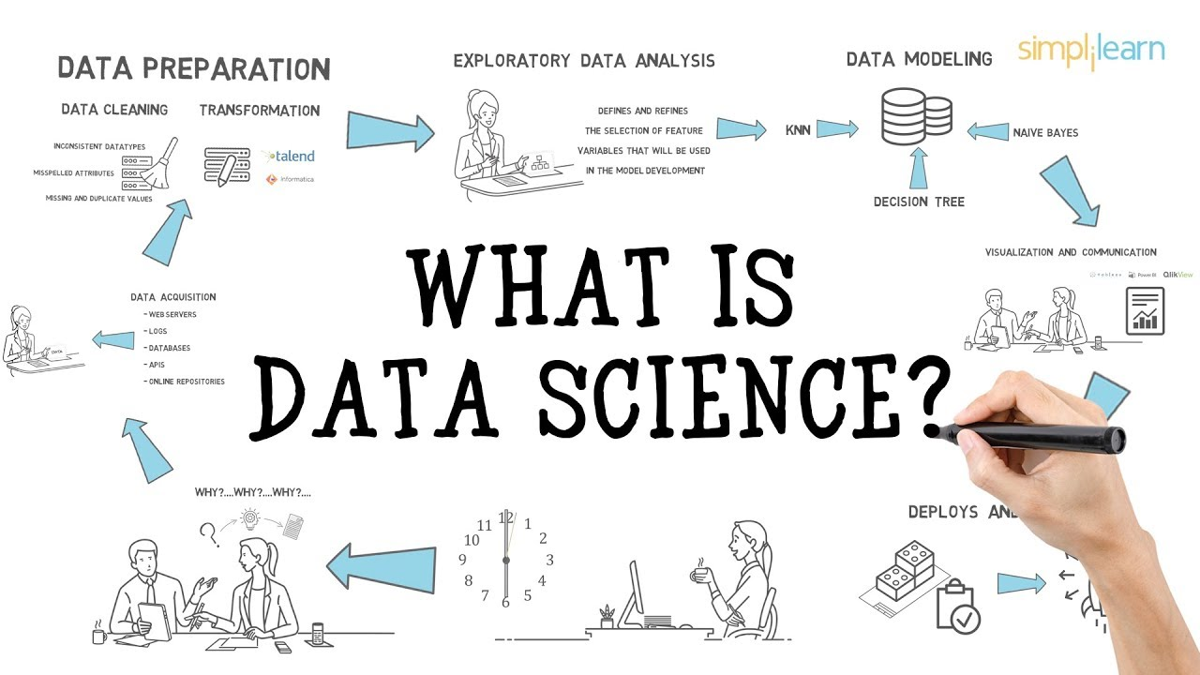
What is Data Science?
Notes:
Image: https://i.ytimg.com/vi/X3paOmcrTjQ/maxresdefault.jpg
Youtube: https://www.youtube.com/watch?v=X3paOmcrTjQ

Slide 5
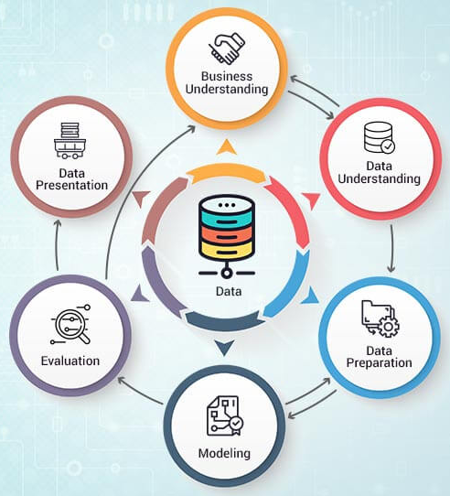
Data Science Project Lifecycle
What is involved in a successful data science project?
CRISP-DM (Cross-Industry Standard Process for Data Mining, 1996).
Notes:
CRISP-DM Image from: http://www.proglobalbusinesssolutions.com/six-steps-in-crisp-dm-the-standard-data-mining-process/

Slide 6
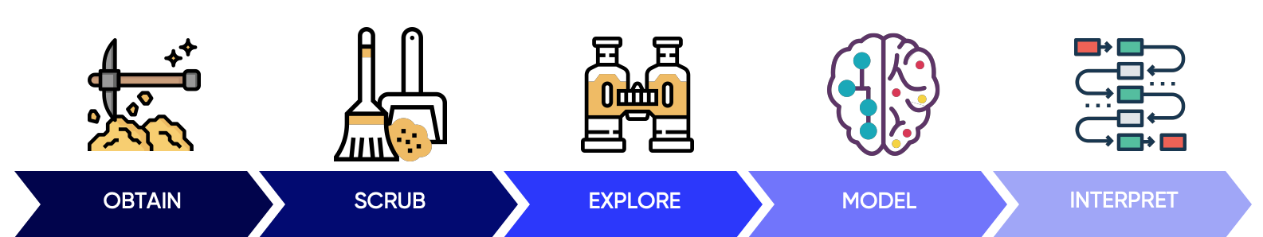
Data Science Project Lifecycle
Some common elements to many Data Science lifecycle, framework, pipeline or workflow.
OSEMN (“awesome”) pipeline model
https://machinelearningmastery.com/how-to-work-through-a-problem-like-a-data-scientist/
Notes:
OSEMN model from: https://towardsdatascience.com/5-steps-of-a-data-science-project-lifecycle-26c50372b492

Slide 7
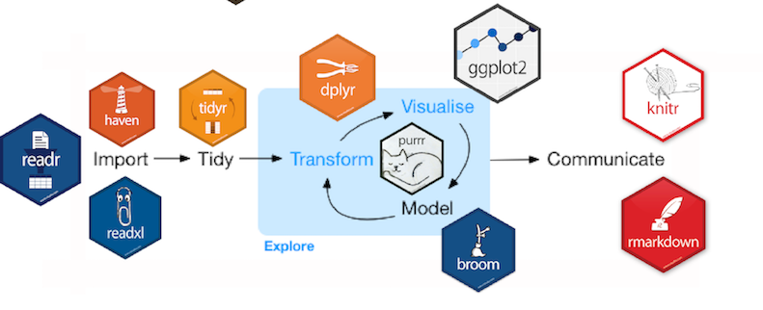
Data Science Project Lifecycle
R/tidyverse packages provide tools tailored to the common tasks in each phase of the Data Science lifecycle
Notes:
Image from: https://rworkshop.uni.lu/lectures/lecture07_plotting.html#4

Slide 8
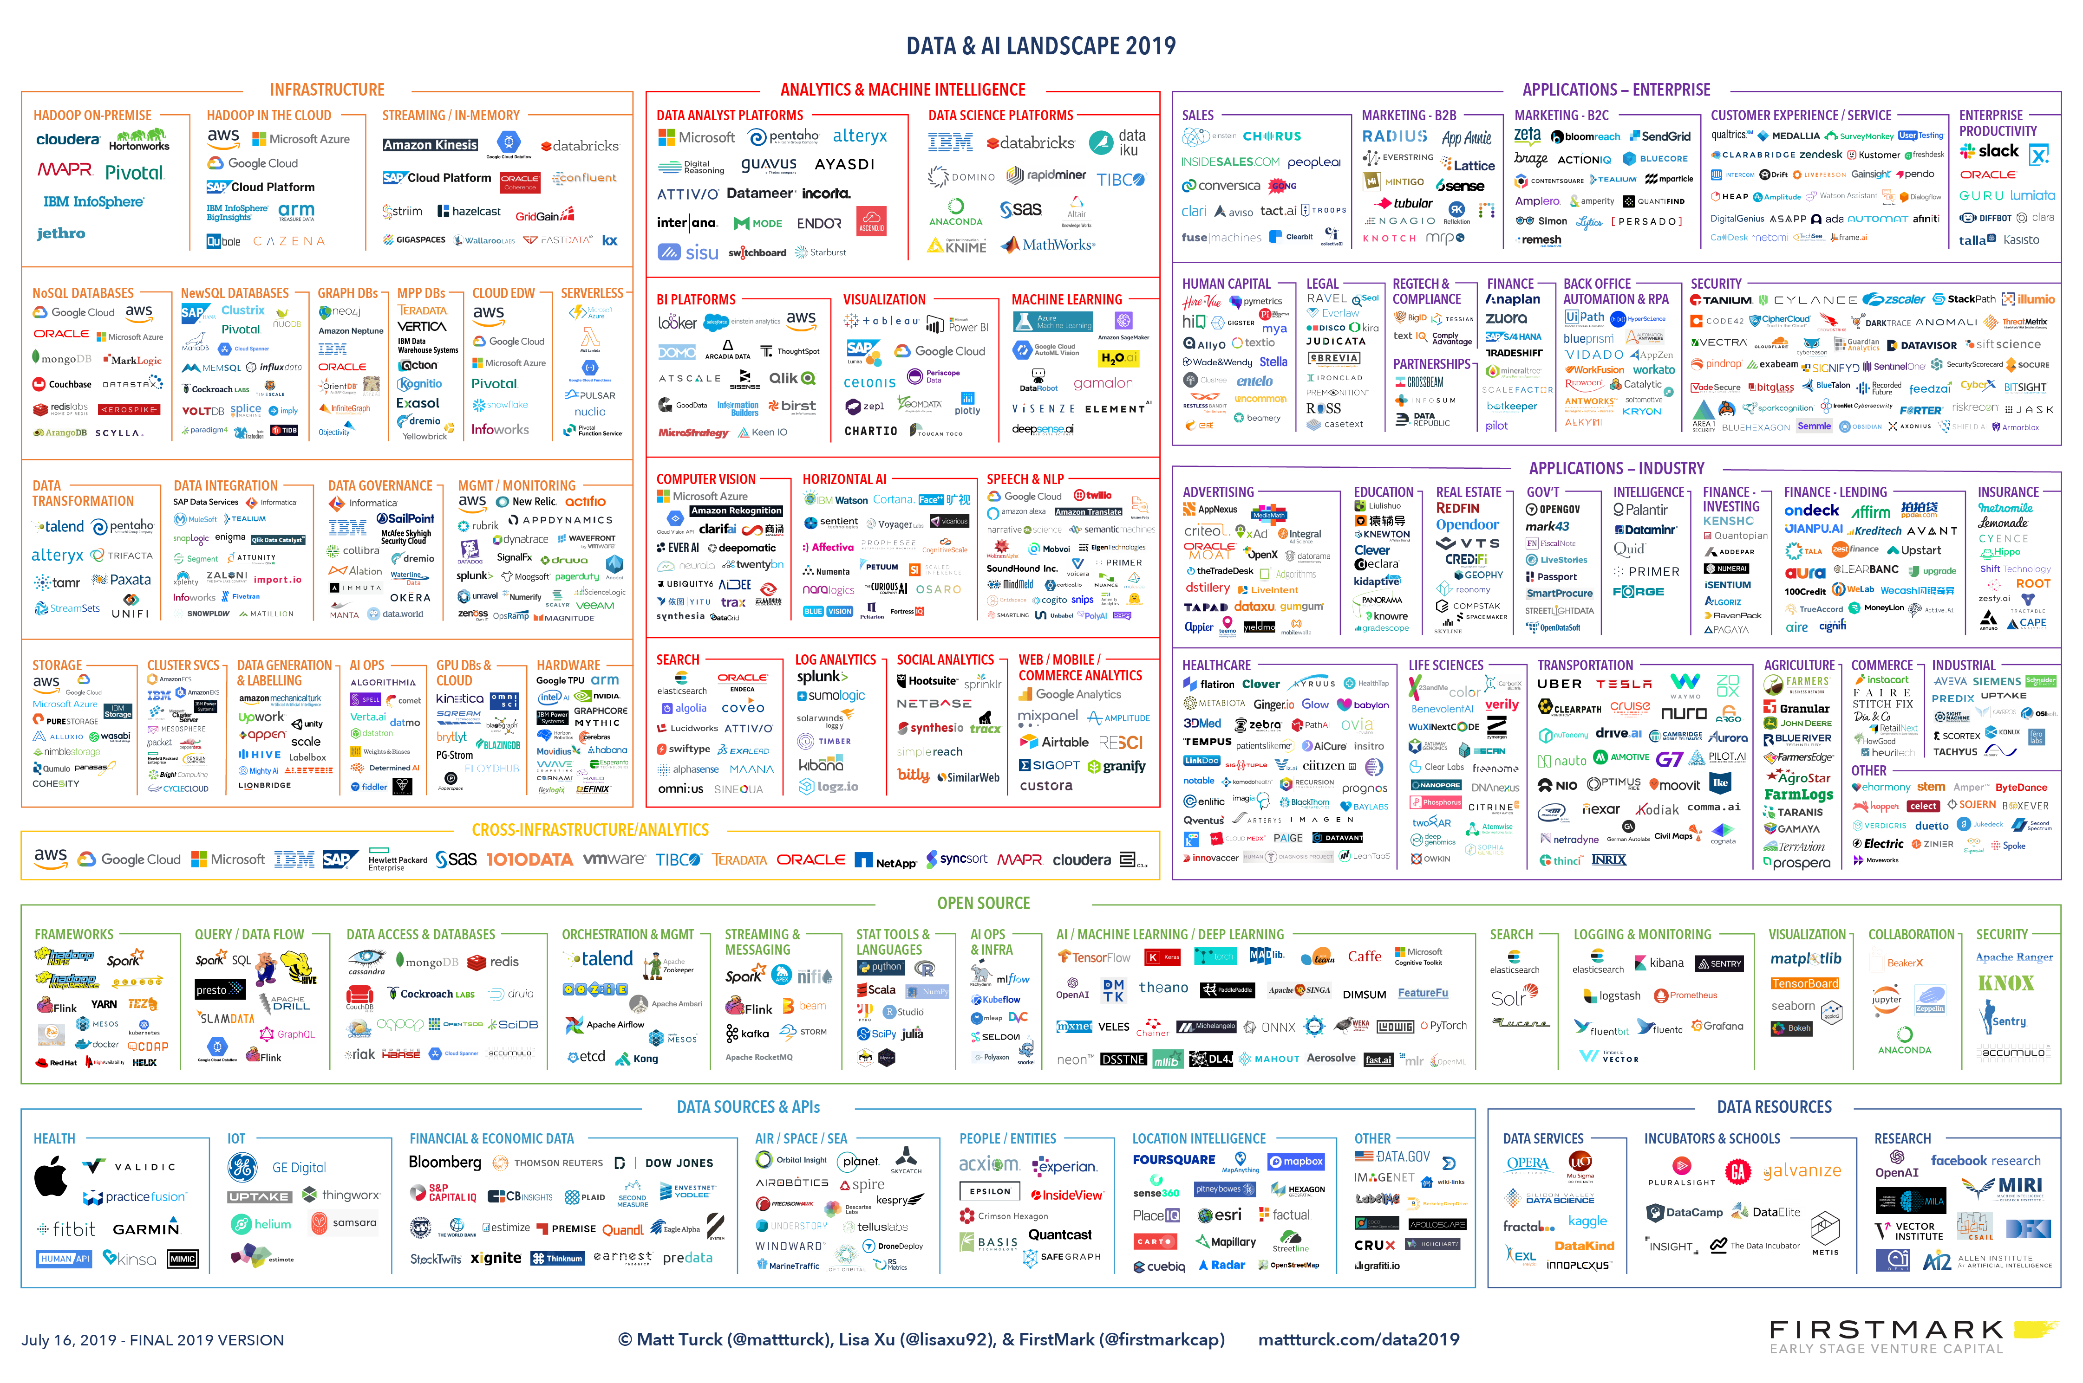
Data and AI Landscape
Notes:
Article: https://mattturck.com/data2019/
Full size image: http://mattturck.com/wp-content/uploads/2019/07/2019_Matt_Turck_Big_Data_Landscape_Final_Fullsize.png

Slide 9
Summary
Data Scientist role involves knowledge and skills from many other roles.
Many different descriptions of a Data Science project lifecycle (with common elements).
Example: OSEMN (“awesome”) pipeline model

Slide 10
Class Discussion Question
Briefly outline how each phase of the OSEMN pipeline (data science lifecycle) could be applied to a large online retail company (such as Amazon).
Follow up: https://machinelearningmastery.com/how-to-work-through-a-problem-like-a-data-scientist/

